Slide 1
Course Recommender System
with Supervised Machine Learning
Bo-Yan Huang
2024 1/16

Slide 2
Introduction - Background
Smartphones have become indispensable in our daily lives. We aim to develop an app capable of monitoring human activities using the inertial sensors embedded in a waist-mounted smartphone. This app will serve to track exercise levels, detect falls, and identify periods of unconsciousness.
Our goal is to classify participants' activities into six categories: walking, walking upstairs, walking downstairs, sitting, standing, and laying. To achieve this, we will utilize the Human Activity Recognition with Smartphones database. This dataset is compiled from recordings of study participants who carried smartphones with embedded inertial sensors while engaging in various activities of daily living (ADL).
Notes:
Smartphones have become indispensable in our daily lives. We aim to develop an app capable of monitoring human activities using the inertial sensors embedded in a waist-mounted smartphone. This app will serve to track exercise levels, detect falls, and identify periods of unconsciousness.
Our goal is to classify participants' activities into six categories: walking, walking upstairs, walking downstairs, sitting, standing, and laying. To achieve this, we will utilize the Human Activity Recognition with Smartphones database. This dataset is compiled from recordings of study participants who carried smartphones with embedded inertial sensors while engaging in various activities of daily living (ADL).

Slide 3
Introduction - Challenges
Data Quality and Variability: The quality and variability of sensor data collected from wearable smartphones can significantly impact the model's performance. Variations in user behavior, device placement, and environmental conditions may introduce noise and affect the accuracy of motion classification.
Model Generalization Across Users: Users have diverse walking patterns, body sizes, and device placements. Achieving a model that generalizes well across different users is challenging, as individual variations can lead to overfitting or underfitting issues.
Real-time Inference: Real-time classification of human activities while managing power consumption on a wearable device is a critical challenge. The app needs to efficiently process sensor data, make predictions promptly, and operate within the constraints of limited battery resources.

Slide 4
Introduction - Transfer Learning
Data Quality and Variability: The quality and variability of sensor data collected from wearable smartphones can significantly impact the model's performance. Variations in user behavior, device placement, and environmental conditions may introduce noise and affect the accuracy of motion classification.
Model Generalization Across Users: Users have diverse walking patterns, body sizes, and device placements. Achieving a model that generalizes well across different users is challenging, as individual variations can lead to overfitting or underfitting issues.
Real-time Inference: Real-time classification of human activities while managing power consumption on a wearable device is a critical challenge. The app needs to efficiently process sensor data, make predictions promptly, and operate within the constraints of limited battery resources.

Slide 5
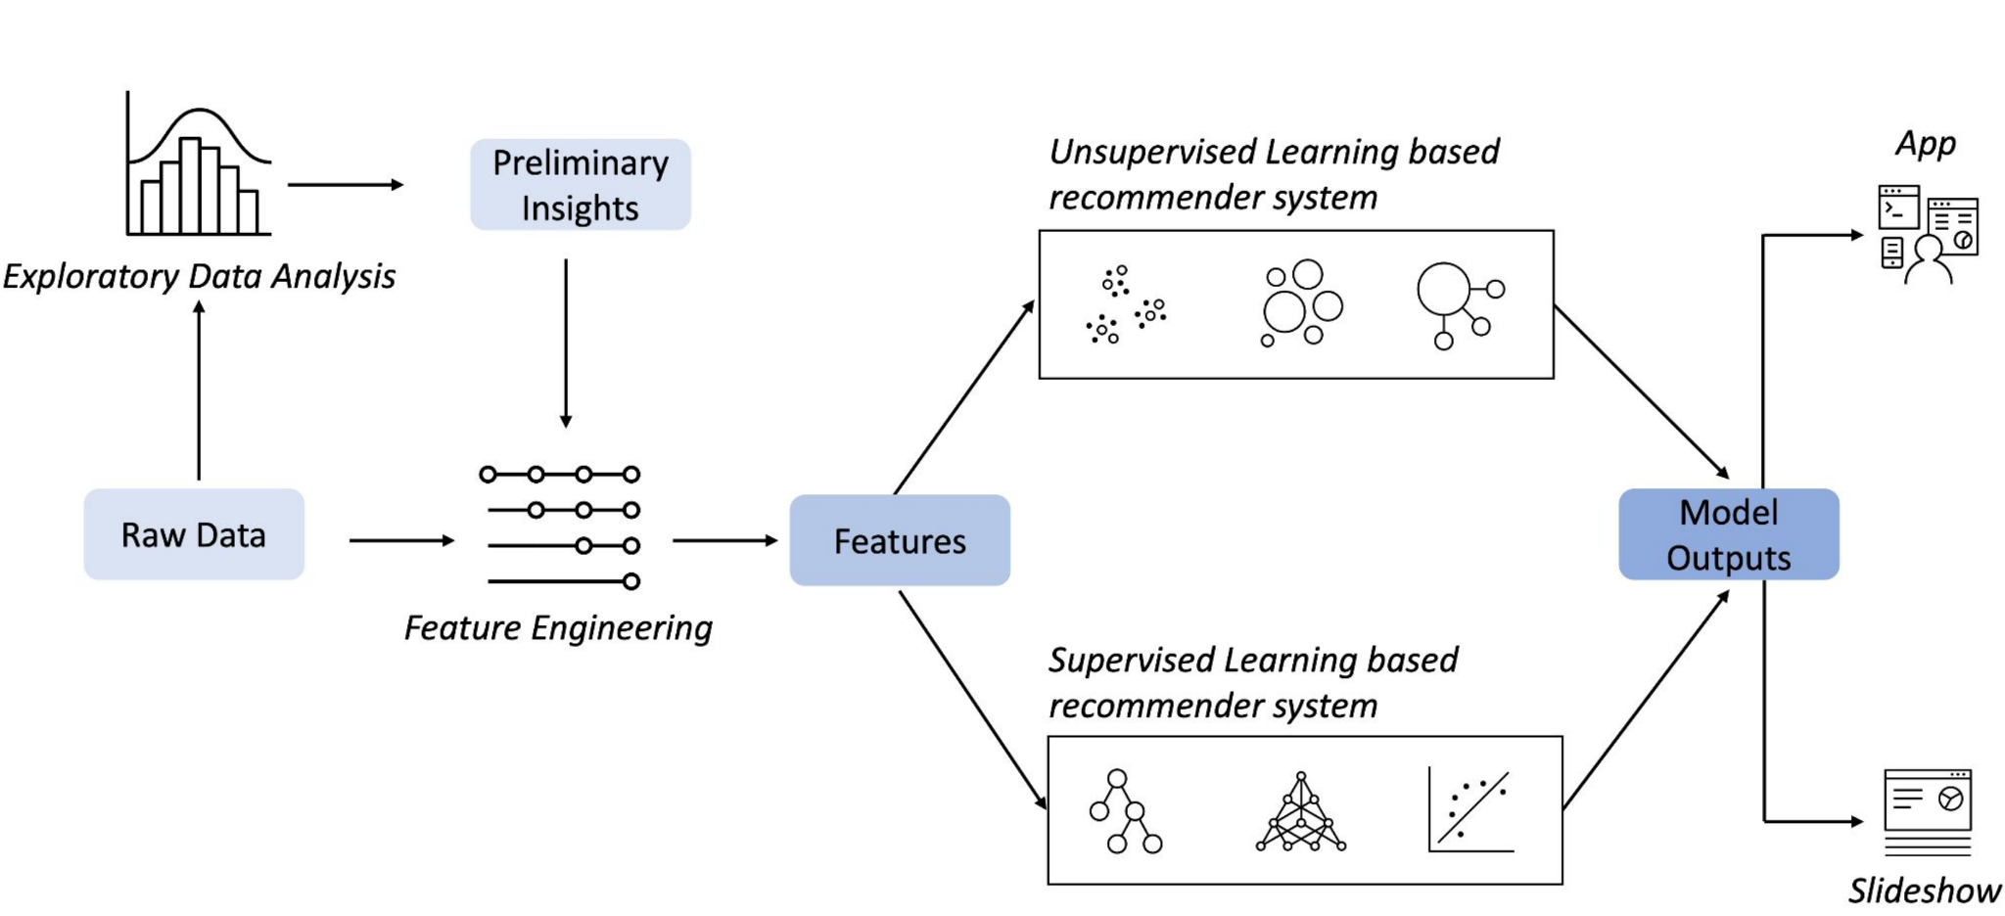
Machine Learning Workflow

Slide 6
Exploratory Data Analysis
Statistical Overview
Key feature Identification
Find Popular Activities
Summary Statistics and Visualizations for the data

Slide 7
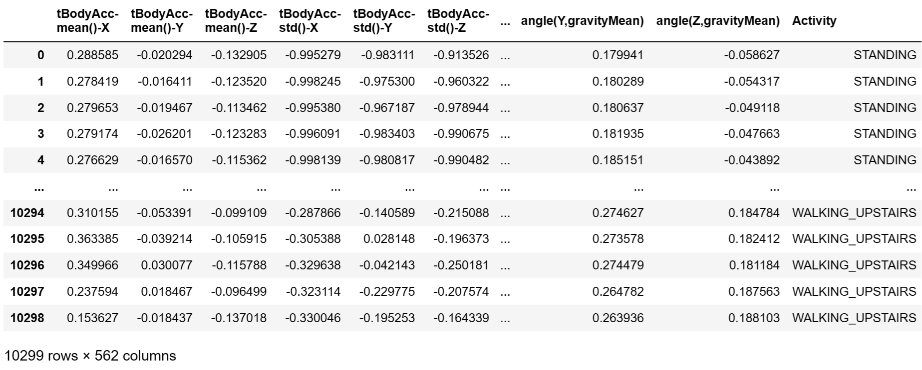
Columns/Features of the Data:
Notes:
The data are all scaled from -1 (minimum) to 1.0 (maximum), therefore we don’t need to scale the floating point values. Notice that the dtype of Activity column is object and Scikit learn classifiers won't accept a sparse matrix for the prediction column. Thus, either LabelEncoder needs to be used to convert the activity labels to integers, or if DictVectorizer is used, the resulting matrix must be converted to a non-sparse array.

Slide 8
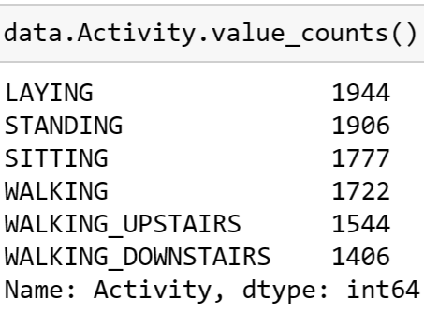
Examine the breakdown of activities
The activity labels are relatively balanced
Notes:
If we examine the breakdown of activities; we can find that they are relatively balanced.

Slide 9
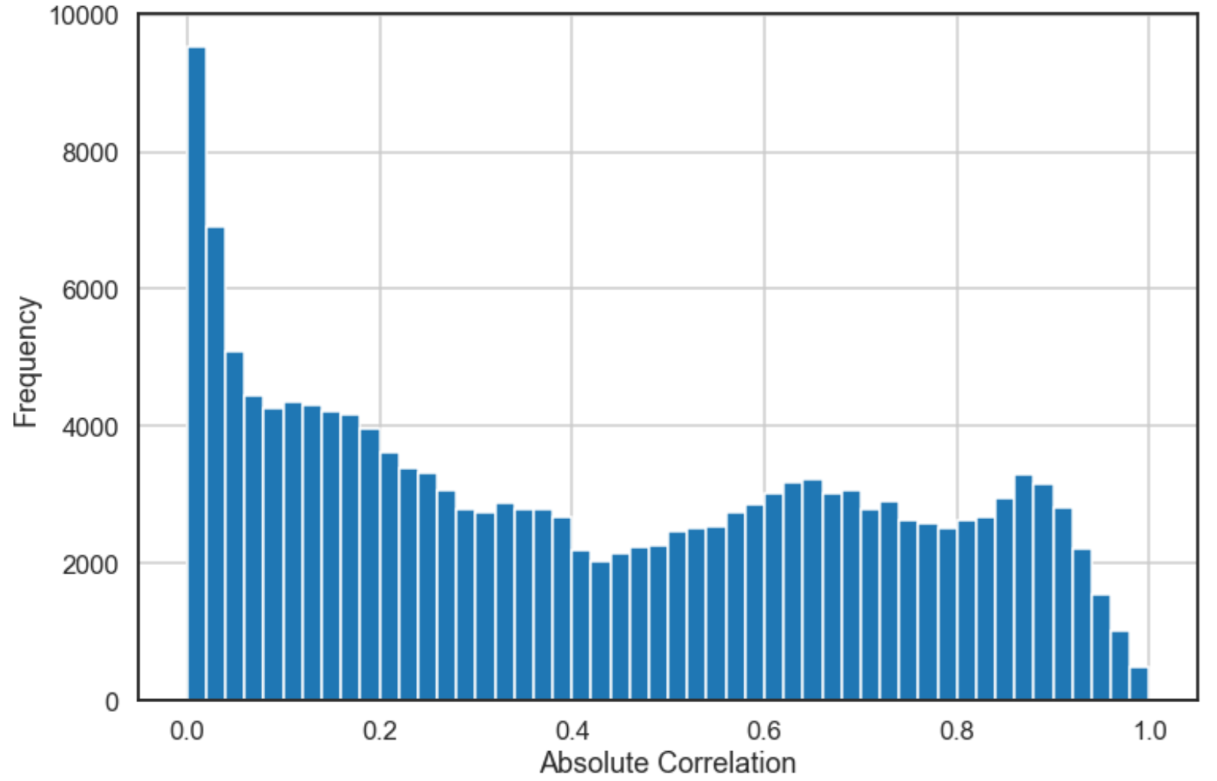
Correlations
Plotting a correlation matrix is impractical due to the extensive number of features, exceeding 500. However, we can identify those that are most correlated.
Notes:
Plotting a correlation matrix is impractical due to the extensive number of features, exceeding 500. However, we can identify those that are most correlated.

Slide 10
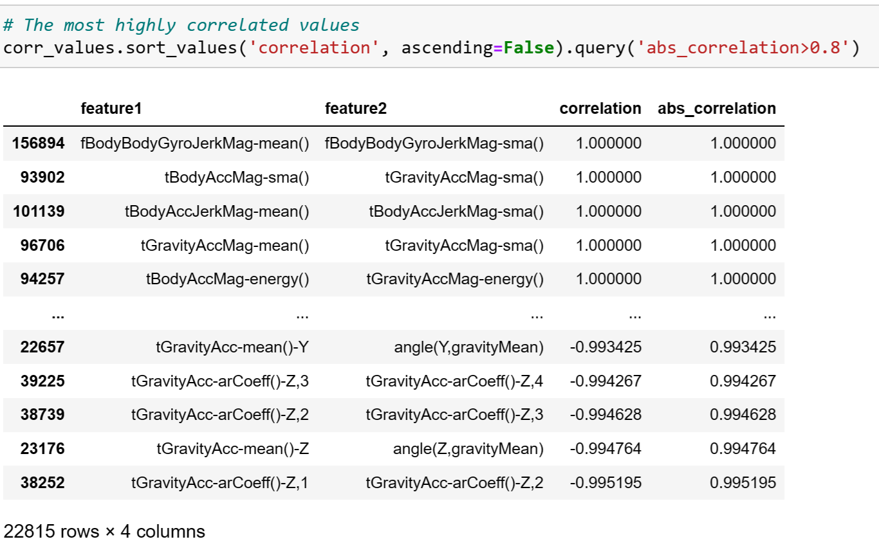
Correlations
Certain features exhibit identical characteristics but are denoted by different labels, leading to a correlation coefficient of 1. It is safe to exclude these redundant features.
Notes:
We observe notable correlations among certain features, such as fBodyBodyGyroJerkMag-mean() and fBodyBodyGyroJerkMag-sma(). These features are essentially equivalent, as sma denotes a simple mean average.

Slide 11
Flowchart of clustering-based recommender system
User/Item feature engineering
Evaluation of the models
Raw data
Model training
A 561-feature vector with time and frequency domain variables including Triaxial acceleration, the estimated body acceleration, Triaxial Angular velocity from the gyroscope and Activity label
Normalization
Handling Missing Data and Outliers
Apply PCA on feature vectors to reduce dimensions
Choose an appropriate supervised machine learning algorithm and train the model.
Assess the model to determine if it meets our requirements. If not, revisit the previous step for further refinement.
Notes:
For this dataset, feature engineering is straightforward as there are no missing data or outliers. All floating-point values fall within the range of -1 to 1, eliminating the need for scaling. However, PCA can be applied to reduce dimensions since some features exhibit high correlation.

Slide 12
Model Comparison
Algorithm | Logistic Regression | KNN | Gradient Boosted Trees | SVC
Interpretability | Provides coefficients that indicate the impact of features. | No explicit model, making it less interpretable. | Less interpretable due to complex ensemble structures. | Can be less interpretable, especially in high-dimensional spaces.
Handling Non-Linearity | Assumes a linear relationship between features and the log-odds. | Suitable for capturing non-linear patterns. | Can capture non-linear relationships effectively. | Can handle non-linear decision boundaries with kernel functions.
Scalability | Highly scalable. | Not very scalable, especially during inference. | Less scalable due to ensemble complexity. | Can be less scalable on large
Parameter Sensitivity | Limited hyperparameters, often robust. | Sensitive to the choice of k. | Sensitive to hyperparameters, requires tuning. | Sensitive to the choice of kernel and regularization parameters.
Multiclass | Available | Available | Available | Need to extend SVMs, may not generalize well.
Training Speed | Fast training on large datasets. | Lazy learner, slow during inference. | Slower training, especially with deep trees. | Can be slow on large datasets, especially with non-linear kernels.
Notes:
In our scenario, the model is required to facilitate multiclass classification. It should also demonstrate proficiency in managing non-linear relationships, and there is no necessity for employing an extensive dataset. While training speed and interpretability are preferred, they are not mandatory.
SVMs are inherently designed for binary classification, meaning they are originally formulated for distinguishing between two classes. Although there are strategies, such as one-vs-one or one-vs-all, to extend SVMs to multi-class problems, these approaches may not always generalize well.

Slide 13
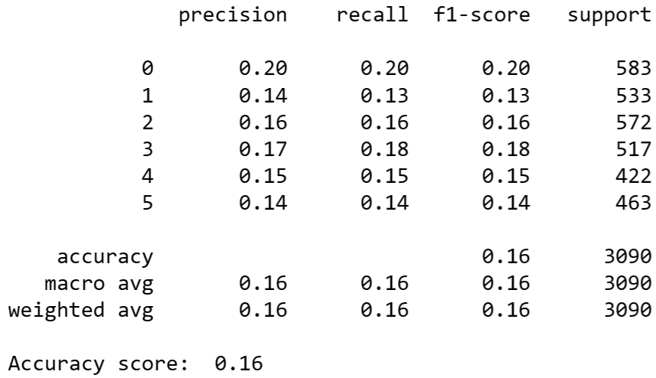
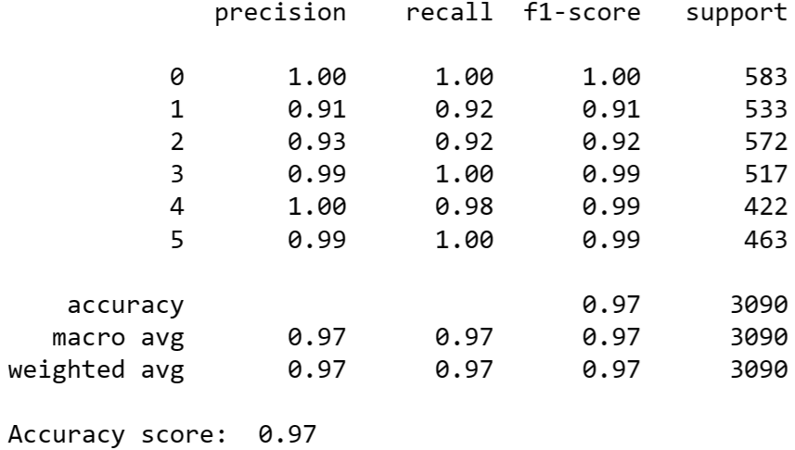
Evaluation results
DummyClassifier
KNeighborClassifier

Slide 14
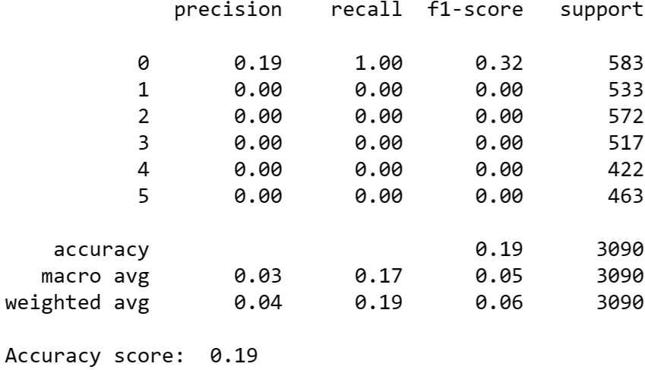

Evaluation results
SVC
GradientBoostingClassifier

Slide 15
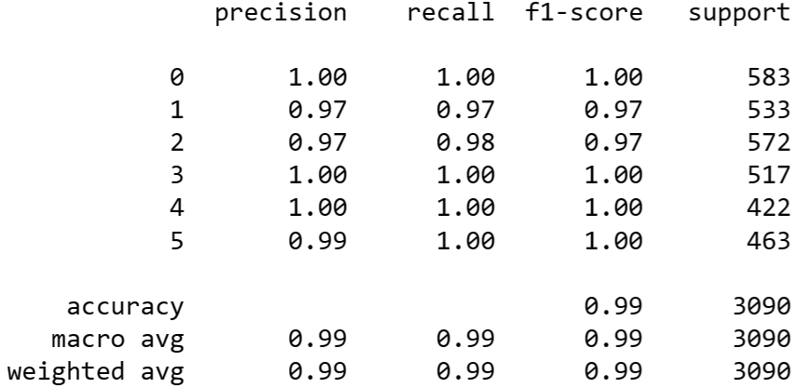
Combining models
VotingClassifier
We fused logistic regression and gradient boosted trees to create a voting classifier. This new ensemble model enhanced precision and recall for activities 3 and 4, albeit resulting in a slight reduction in classification performance for activities 1 and 2.
Notes:
Performance for the voting classifier should improve relative to either logistic regression or gradient boosted trees alone. However, the fact that logistic regression does almost as well as gradient boosted trees is an important reminder to try the simplest model first. In some cases, its performance will be good enough.

Slide 16
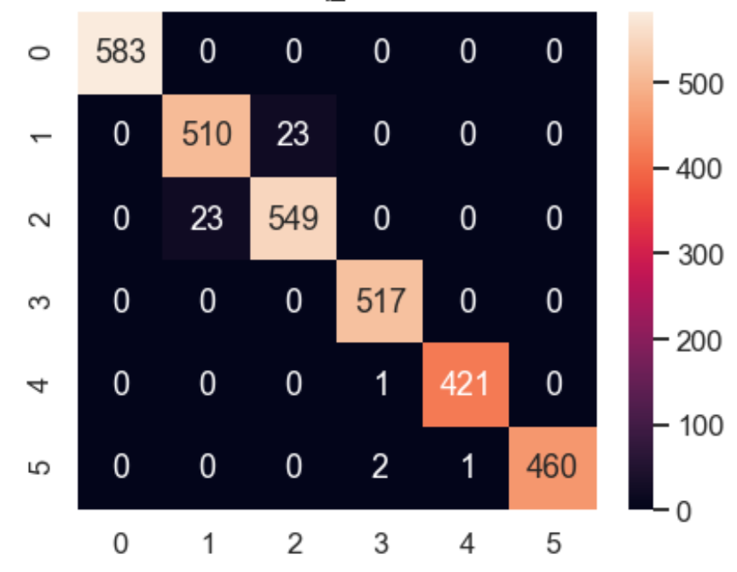
Confusion Matrix
We fused logistic regression and gradient boosted trees to create a voting classifier. This new ensemble model enhanced precision and recall for activities 3 and 4, albeit resulting in a slight reduction in classification performance for activities 1 and 2.
Notes:
We fused logistic regression and gradient boosted trees to create a voting classifier. This new ensemble model enhanced precision and recall for activities 3 and 4, albeit resulting in a slight reduction in classification performance for activities 1 and 2.

Slide 17
Conclusions
We can group users based on the genre in their profiles and suggest courses that are popular within the same cluster.
Applying PCA to user profile feature vectors can decrease dimensions, consequently reducing computational power requirements
The K-means method is preferred for our project.
We have the flexibility to fine-tune the number of recommended courses by adjusting the popular ratio parameter.

Slide 18
Outlook
Possible issues:
Lower accuracy/recall for activity 2, 3 prediction:
The accuracy and recall are almost one, except for predictions related to activity 2 and 3, where a decrease in performance is observed.
Sensor functionality: The collected data exclusively originates from operational sensors, and data from malfunctioning sensors has been excluded.

Slide 19
Outlook
Possible solutions:
Lower accuracy/recall for activity 2, 3 prediction:
The data can be partitioned into two different dataset: one for instances with labels 2 and 3, and another for the remaining labels. Subsequently, we can train a dedicated model for predicting activities 2 and 3 and a separate model for the remaining activities. Combining the outputs of these specialized models is expected to yield improved results.
Sensor functionality: We should introduce a new label, such as 'Not Available,' to signify data originating from malfunctioning sensors. Subsequently, we can train a model with the capability to detect whether the sensors are operational or broken.

Slide 20
Appendix
Data source: https://cf-courses-data.s3.us.cloud-object-storage.appdomain.cloud/IBM-ML241EN-SkillsNetwork/labs/datasets/Human_Activity_Recognition_Using_Smartphones_Data.csv
Courses:
https://www.coursera.org/learn/supervised-machine-learning-classification/home
Jupyter notebook:
https://github.com/r95222023/IBM-Machine-Learning-Professional-Certificate/tree/main/Supervised%20Machine%20Learning%20-%20Classification

